Slide 1


ML Pipeline
Big Data Machine Learning Pipeline
YELP OPEN DATASET ANALYTICS & SENTIMENT CLASSIFICATION REPORT
Data Engineering Team, Sentiment Analysis Division
May 10, 2026
Begin Presentation

Slide 2

Rimberio
Home
About
Contact
Project Overview
SUMMARY OF PROJECT SCOPE AND SCALE
Dataset: Yelp Open Dataset (2024 release) featuring 150,346+ businesses and 6,990,280+ reviews across 11 cities. Three ML classifiers trained for sentiment classification. Goal: production-grade pipeline for large-scale sentiment analysis.

Slide 3

Yelp ML
Home
About
Contact
Team Members
TEAM MEMBERS I
&
TEAM MEMBERS II
Mahmoud Montaseb (230105746)
Mohaned Ehab Rady (230100004)
Mahmoud Usama (230103270)
Omar Abdulaal (230103273)
Abdullah Abdelsattar (230105204)
Mariam Khalil (230101798)

Slide 4


Big Data ML
04
of 19
Tech Stack
Technology Stack
OVERVIEW OF TOOLS POWERING THE PIPELINE
• Data Storage: Apache Cassandra (distributed NoSQL)
• ML Training: Apache Spark (distributed processing)
• Data Preparation: Python 3.11+
• NLP Embeddings: sentence-transformers, Word2Vec
• Visualization: Seaborn, Matplotlib, Plotly
• Containerization: Docker Compose

Slide 5

Yelp Analytics
Home
About
Contact
Data Pipeline & Quality Rules
DATA INGESTION, CLEANING & PREPARATION
Ingested & cleaned 7M+ reviews and 150K+ business records. Modular prepare_data.py pipeline with: Unicode NFKC normalization, URL & email removal, case folding to lowercase, punctuation stripping except apostrophes, length filtering (15–8,000 chars), deduplication by (business_id, cleaned_text).

Slide 6
Yelp ML
Code
Docs
Pipeline
Review Text Cleaning Function
6
KEY FEATURES
LISTING 3: CLEAN_REVIEW_TEXT
def clean_review_text(text):
text = unicodedata.normalize('NFKC', text)
text = re.sub(r'http\S+|\S+@\S+', '', text)
text = text.lower()
text = re.sub(r"[^\w\s']", '', text)
if len(text) < 15 or len(text) > 8000:
return None
return text.strip()
• Punctuation stripping (preserves apostrophes)
• Length filtering: 15–8,000 characters
• Returns None for invalid inputs
• Modular design for pipeline integration

Slide 7

Yelp Analytics
7/19
Features
Pipeline
ML Problem Definition & Feature Engineering
BINARY SENTIMENT CLASSIFICATION TASK
Classification: Positive (≥4 stars) vs Negative (<4 stars)
Feature Engineering:
• TF-IDF vectors for term importance
• N-grams for phrase patterns
• Category vectors for business context
• 384-dimensional sentence embeddings

Slide 8
Yelp ML
Home
About
Contact
Automatic Embedding Fallback
Listing 4
PRIMARY METHOD
PYSPARK FALLBACK
try:
from sentence_transformers
import SentenceTransformer
model = SentenceTransformer(
'all-MiniLM-L6-v2')
embeddings = model.encode(
texts, batch_size=32)
Fallback to Word2Vecexcept ImportError:
from pyspark.ml.feature
import Word2Vec
w2v = Word2Vec(
vectorSize=100,
inputCol="words",
outputCol="embeddings")
model = w2v.fit(df)

Slide 9


Yelp Analytics
Home
About
Contact
Models Trained & Approach
OVERVIEW OF CLASSIFIERS AND TRAINING METHODOLOGY
Three classification models trained using Apache Spark distributed processing: Logistic Regression for baseline performance, Random Forest with 100 decision trees for ensemble learning, and Gradient Boosted Trees (GBT) with hyperparameter tuning for optimal accuracy. Train-test split ensures generalization.

Slide 10

Yelp ML
Home
About
Contact
Model Performance Overview
GBT CLASSIFIER ACHIEVES BEST OVERALL PERFORMANCE
Gradient Boosted Trees delivers strong generalization with AUC-ROC of 0.874 and accuracy of 0.811. The train-test gap of only 0.028 indicates excellent model stability without overfitting.

Slide 11
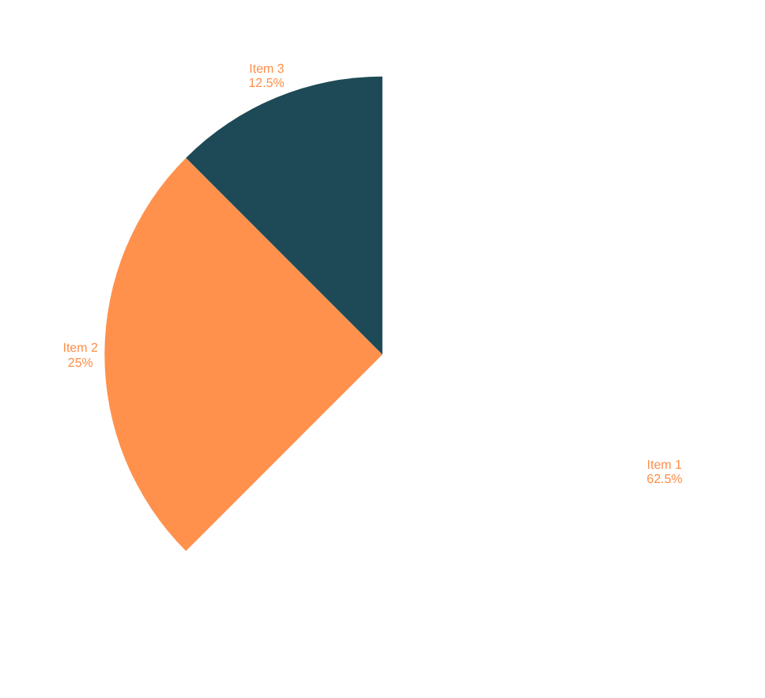
Yelp Analytics
Home
About
Contact
Key Insight 1:
Category Dominance
BUSINESS CATEGORY DISTRIBUTION
Restaurants and Food businesses dominate the Yelp dataset, comprising over half of all analyzed businesses. This concentration reflects the platform's core user base and provides rich data for sentiment analysis in the hospitality sector.

Slide 12

Yelp Analytics
Home
About
Contact
Key Insight 2 – Positivity Bias in Ratings
STAR RATING DISTRIBUTION ANALYSIS
Yelp reviews exhibit a strong positive skew. The modal rating is 4.0 stars, with over 60% of all reviews rated 4 or 5 stars. This positivity bias impacts model training and requires careful class balancing.

Slide 13

Yelp Analytics
Home
About
Contact
Geographic Distribution
TOP CITIES IN THE YELP DATASET
Philadelphia, Phoenix, and Las Vegas dominate the dataset, representing the highest concentration of businesses and reviews across all 11 analyzed cities.

Slide 14

Yelp ML
Home
About
Contact
Review Length & Polarity
KEY INSIGHT 4
Analysis reveals that longer reviews exhibit stronger sentiment polarity signals, making them more valuable for classification. Additionally, 80% of businesses have fewer than 50 reviews, creating a long-tail distribution that impacts model training.

Slide 15
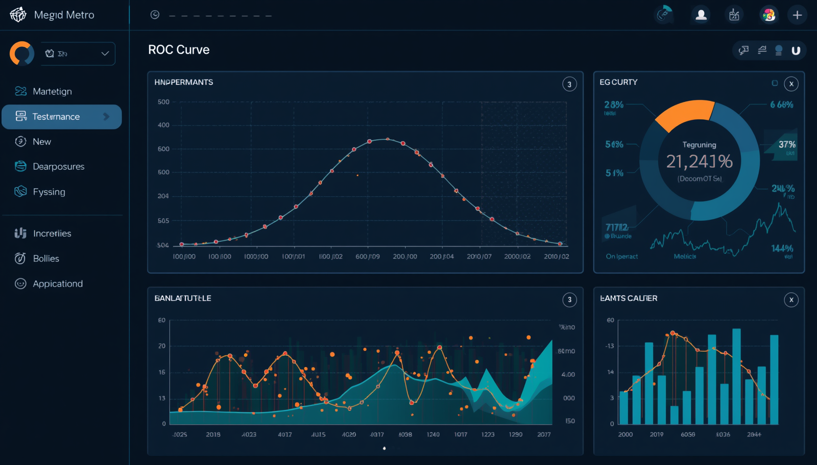
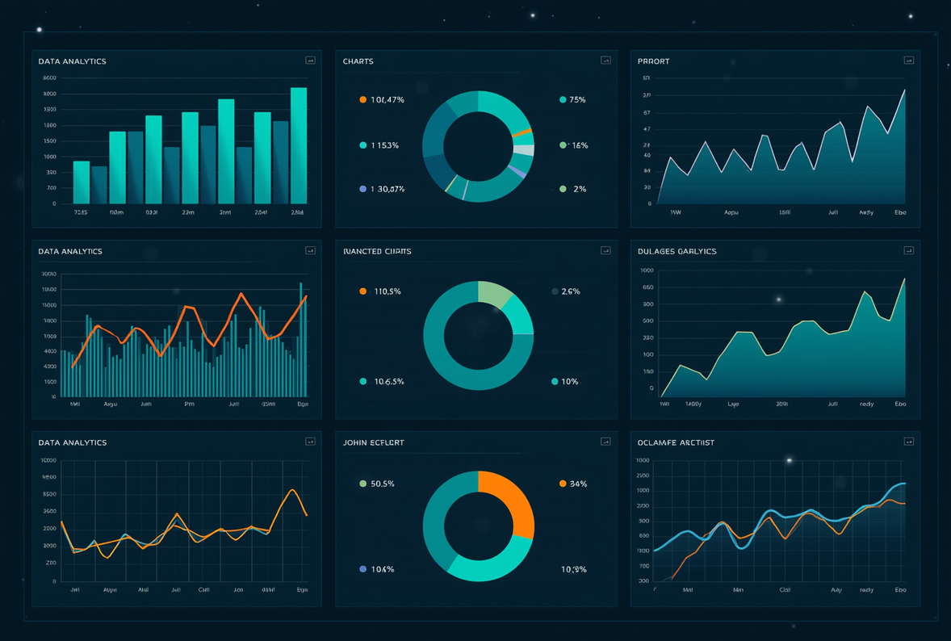
Rimberio
Home
About
Contact
Visualizations Gallery
STATIC & INTERACTIVE DASHBOARD SHOWCASE
Static Visuals: City distribution bar charts, category pie charts, star rating histograms, review count distributions. Interactive Dashboards: ROC curves with hover metrics, performance gauges, radar charts for model comparison, donut charts for category analysis.

Slide 16
BigData ML
Docs
Code
GitHub
Configuration Constants
Listing 5
PIPELINE PARAMETERS
INFRASTRUCTURE SETTINGS
SAMPLE_FRACTION = 0.1
MIN_REVIEW_LENGTH = 15
MAX_REVIEW_LENGTH = 8000
RANDOM_SEED = 42
TRAIN_TEST_SPLIT = 0.8
Cassandra ConnectionCASSANDRA_HOST = "cassandra"
CASSANDRA_PORT = 9042
KEYSPACE = "yelp_analytics"
REPLICATION_FACTOR = 1

Slide 17
BigData ML
Home
About
Contact
Docker Compose Workflow
→
SETUP & DATA PREP
TRAIN & VISUALIZE
Start all servicesdocker-compose up -d cassandra spark
Prepare and clean datadocker-compose exec spark-master
python prepare_data.py
Run exploratory analysisdocker-compose exec jupyter
python run_eda.py
Run ML training pipelinedocker-compose exec spark-master
spark-submit train_models.py
Generate visualizationsdocker-compose exec jupyter
python generate_viz.py

Slide 18

Rimberio
Home
About
Contact
Recommendations & Next Steps
ACTIONABLE SUGGESTIONS FOR FUTURE IMPROVEMENTS
• Expand to multi-class 5-star rating prediction for granular sentiment analysis
• BERT fine-tuning for domain-specific adaptation to review language
• Temporal analysis of rating drift patterns over time
• Develop category-specific sentiment models for improved accuracy
• Implement streaming ingestion with Kafka + Spark for real-time processing

Slide 19

Big Data ML Pipeline
Home
About
Contact
QUESTIONS & DISCUSSION
Thank You!
Thank you for your attention! We welcome any questions about our Yelp sentiment classification pipeline. Contact the Data Engineering Team, Sentiment Analysis Division for follow-up discussions.

